Slide 1
Category review: Chips
December 23
Retail Analytics
Brand note: If client logo is not required, use alternate title page layout right click slide thumbnail > Layout > Title

Slide 2
Notes:
To view Privacy video explaining how important data privacy is to Quantium, please click here: https://www.youtube.com/watch?v=Zq1QDAkoRzU
or here Q:\Company Reference\Brand & Design\Brand videos\Q Privacy.mp4
At Quantium, we believe that data is the behavioural footprint of humanity and that it has to be treated with the utmost care and responsibility.
Histories, attitudes, indeed lives are stored within it in ways that aren’t always apparent – and that’s what makes its potential so powerful.
To work with it responsibly, sensitively, we set ourselves the highest data privacy protection and governance standards.
We have spent 17 years perfecting privacy-by-design and secure-by-design principles. Central to this is not holding any personally identifiable information about people –
we neither receive it, and put the necessary protections in place to be unable to decipher it.
Every aspect of handling data is safeguarded: from its de-identification, to its encryption – data security is paramount and of the highest grade.
We pride ourselves on gaining the trust of iconic organisations around the world through years of securely working with their data,
and in turn the trust that builds with their stakeholders.

Slide 3
Executive summary
01
Task 1
Revenue by each customer segment
Customer insight of each segment
Top Favorite Brand
Top Favorite Package Size
02
Task 2
One control store was selected for each trial store and the values of metrics were compared in trial and pre trial period.
The results for trial stores 77 and 88 during the trial period show a significant difference in at least two of the three trial months but this is not the case for trial store 86.

Slide 4
01
Category

Slide 5
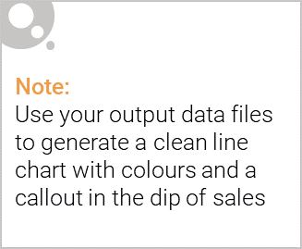
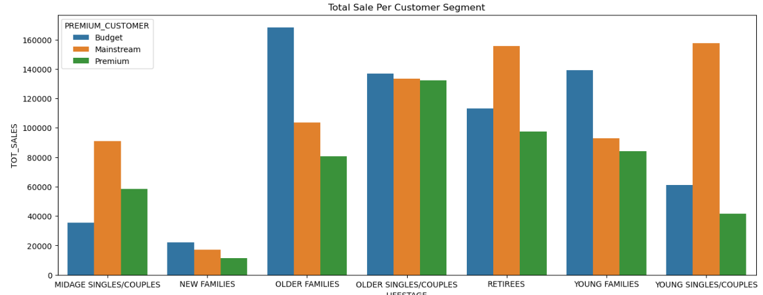
Sales almost came from Old Families – Budget, Retirees – Mainstream and Young Singles/Couples - Mainstream. In total contributing 25% of Sale revenue.

Slide 6
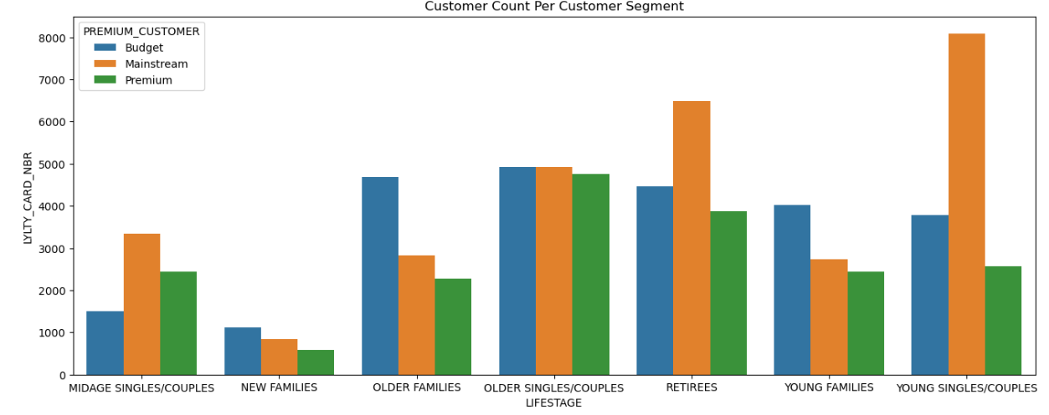
Sales of Older Family –Budget segment almost come from loyal customer
Sale of Retirees – Mainstream and Young Singles/Couples – Mainstream with much more new customer

Slide 7
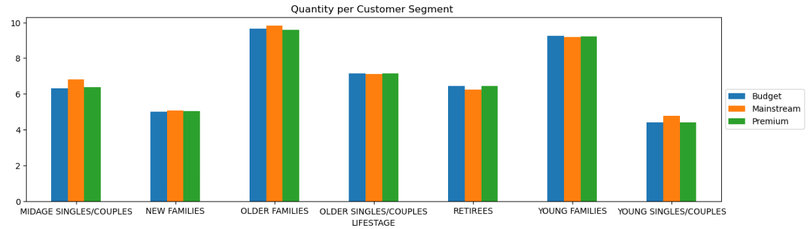
Older and Young Families segment have highest average purchase unit per unique customer
Average Price per Transaction of any customer segment is around 7
Average Quantity per Transaction of any customer segment is 2

Slide 8
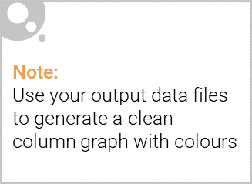




Top 3 Favorite Brand
Top 3 Common Package Size
175g
150g
134g

Slide 9
02
Trial store performance

Slide 10
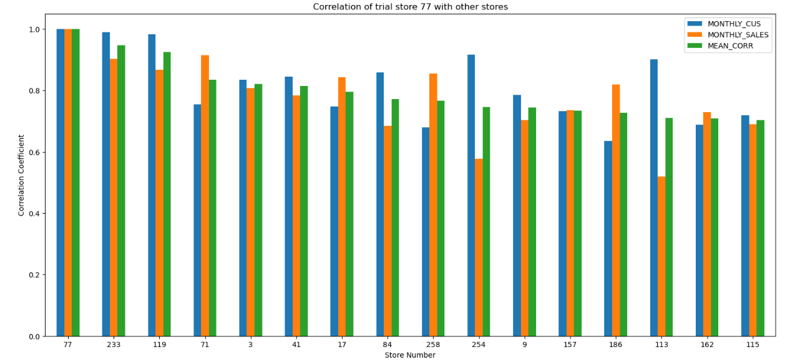
Correlation of the control store 77 vs other stores
Stores with maximum similarities have the highest correlation. So stores 233, 119 and 79 are the most correlated.

Slide 11
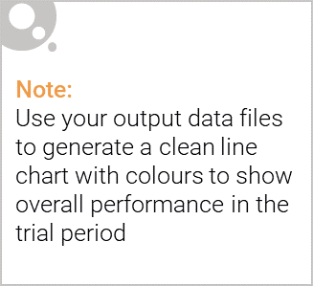
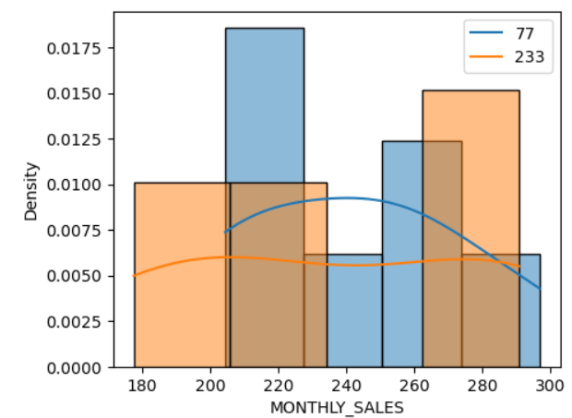
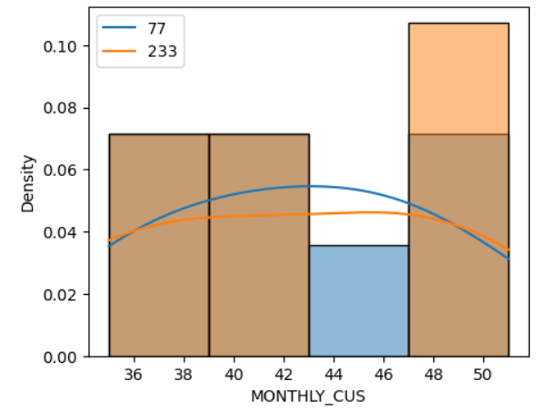
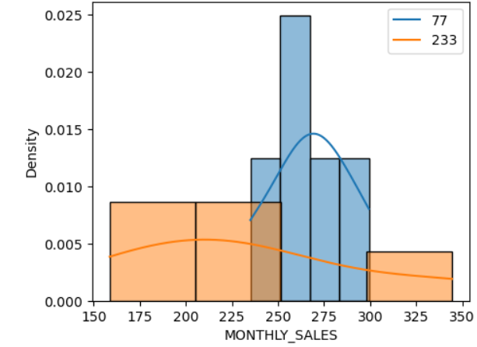
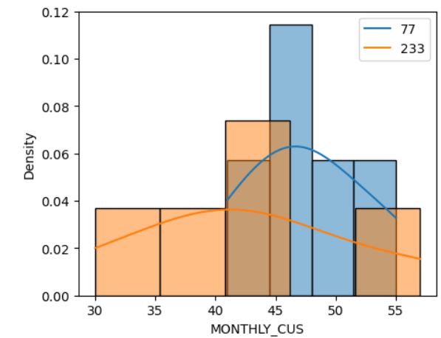
Trial Store 77 vs Store 233
Distributions of total sales and customers in pretrial period
Means don’t vary and there is no significant difference
Distributions of total sales and customers in pretrial period
Means vary and there is a significant difference

Slide 12
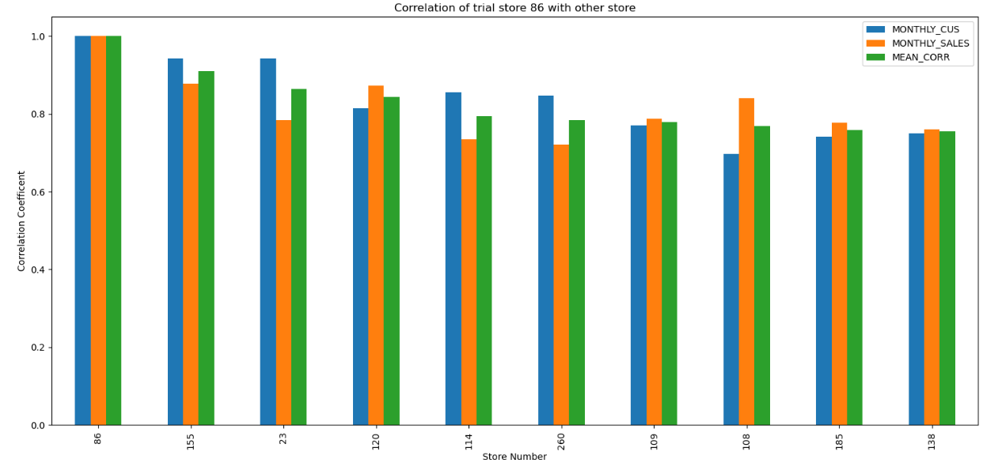
Correlation of the control store 86 vs other stores
Stores with maximum similarities have the highest correlation. So stores 155, 23 and 120 are the most correlated.

Slide 13
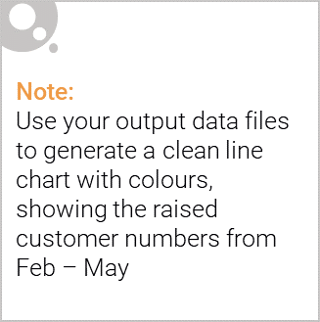
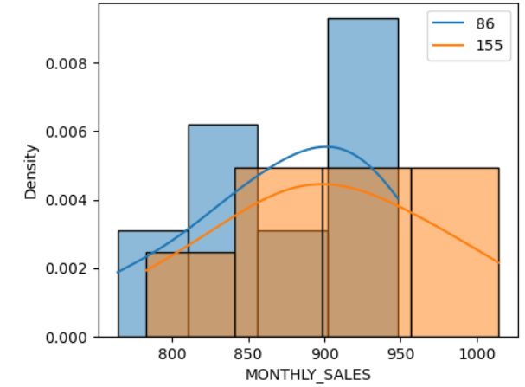
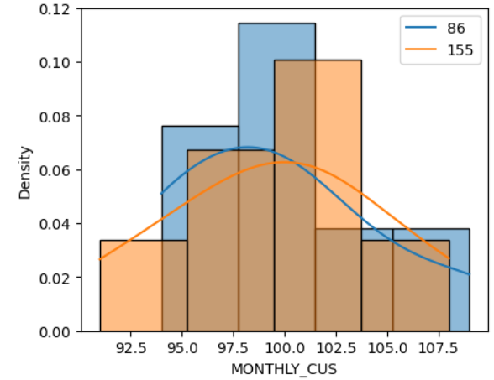
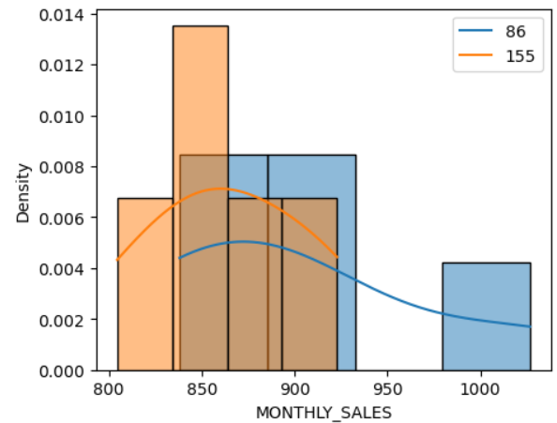
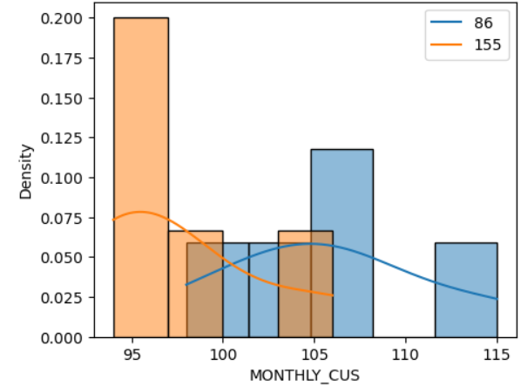
Trial Store 88 vs Store 155
Distributions of total sales and customers in pretrial period
Means don’t vary and there is no significant difference
Distributions of total sales and customers in pretrial period
Means vary and there is a significant difference

Slide 14
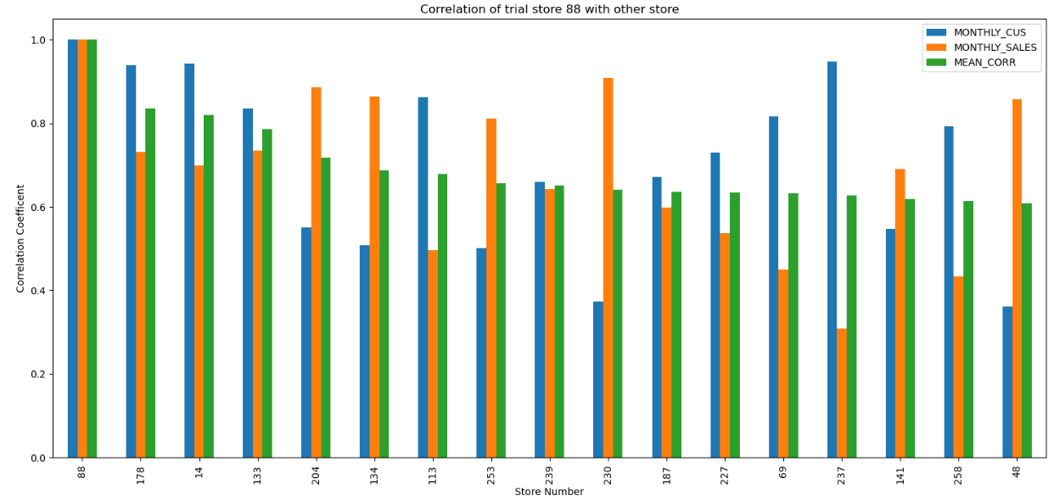
Correlation of the control store 88 vs other stores
Stores with maximum similarities have the highest correlation. So stores 155, 23 and 120 are the most correlated.

Slide 15
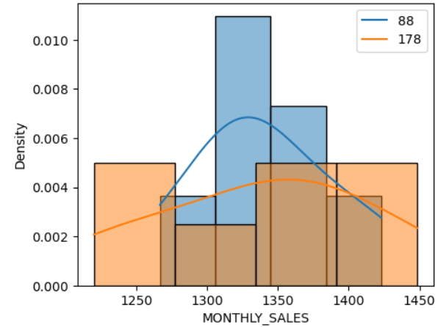
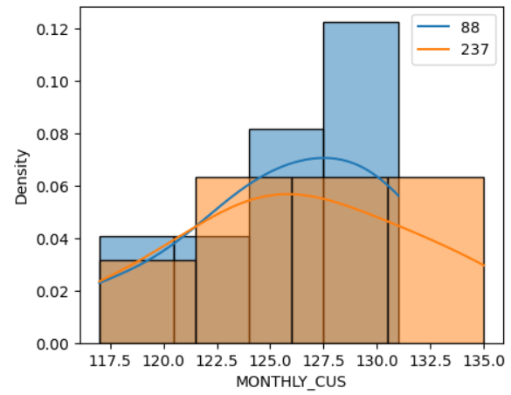
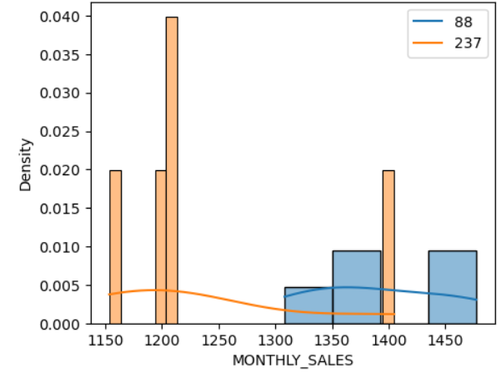
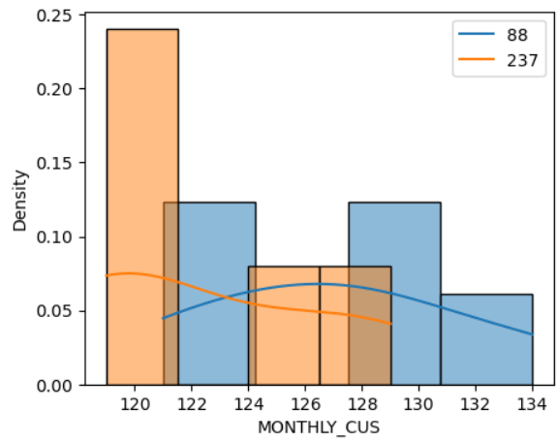
Trial Store 88 vs Store 178
Distributions of total sales and customers in pretrial period
Means don’t vary and there is no significant difference
Distributions of total sales and customers in pretrial period
Means vary and there is a significant difference

Slide 16
Thank You

